Slide 1

A Multi-Study Examination of the Physical and Mental Health Consequences of Burnout in Athletes
Hanna L. Glandorf
Co-authors: Daniel J. Madigan, Owen Kavanagh,
Sarah H. Mallinson-Howard

Slide 2
What is athlete burnout?
An «occupational phenomenon»
- International Classification of Diseases (WHO, 2022)
Emotional and physical exhaustion
Reduced sense of accomplishment
Sport devaluation
Based on Raedeke & Smith (2001)

Slide 3
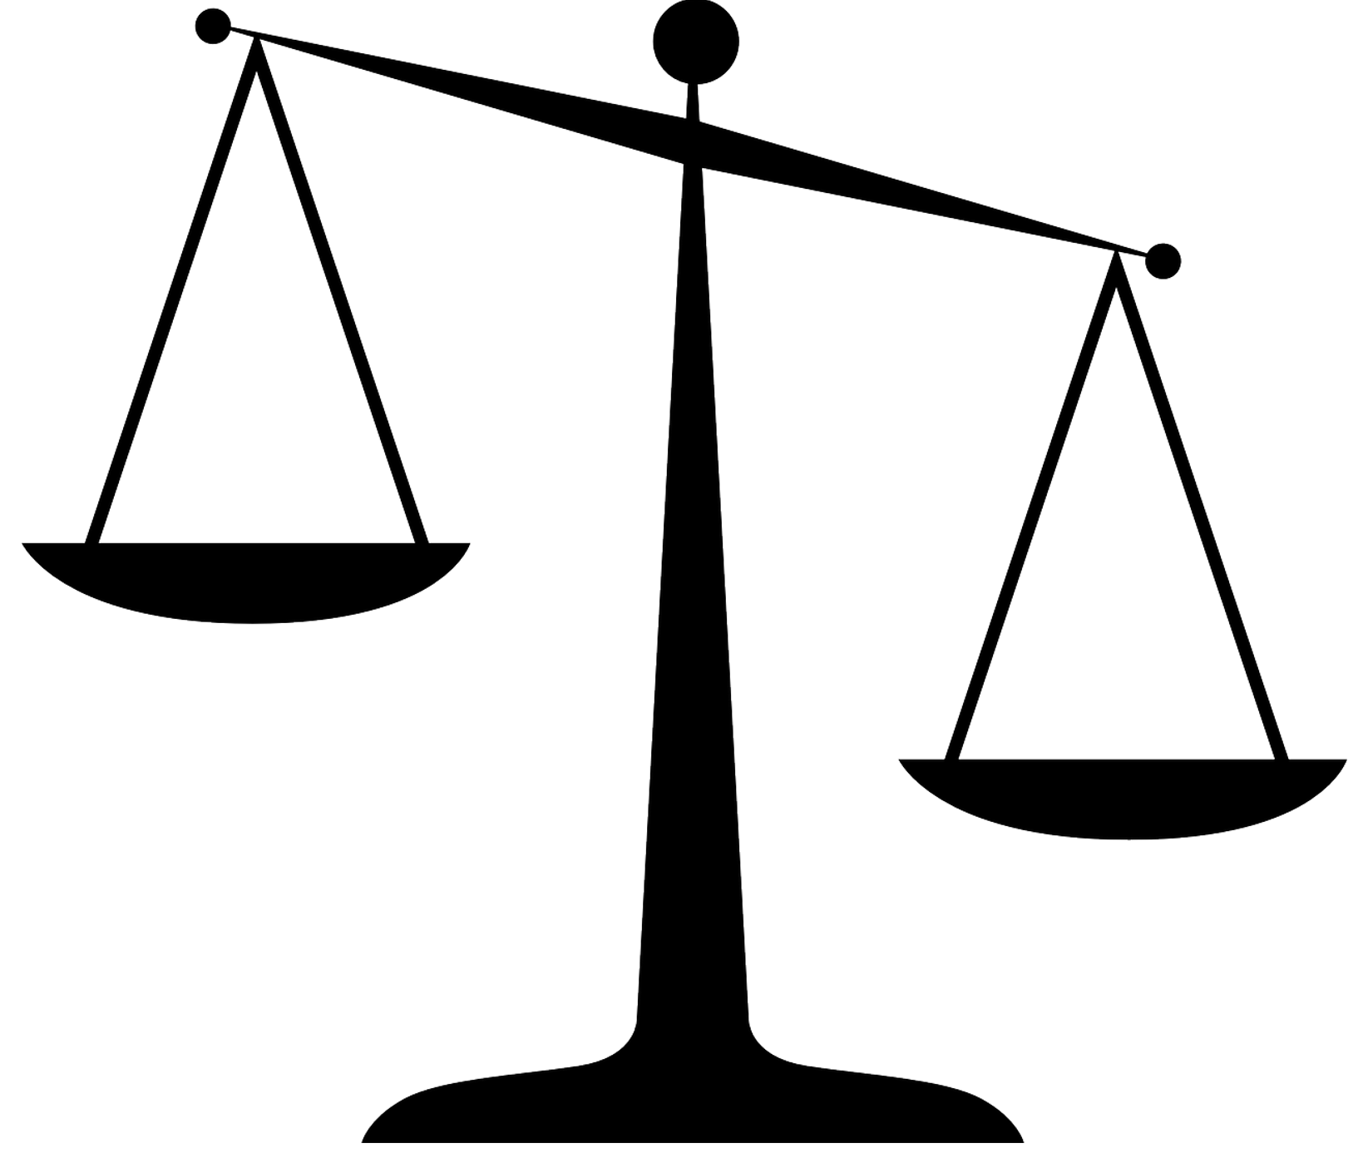
Why would burnout relate to health?
Cognitive appraisal
Physiological responses
(e.g., insomnia, illness susceptibility)
Multisystem dysfunction
(HPA axis, immune system, anabolic activity, cardiovascular system)
Resources
Allostatic overload
Demands
Smith’s (1986) cognitive-affective model of athlete burnout and McEwen & Stellar’s (1993) allostatic load theory

Slide 4
Is burnout associated with health?
Methods Systematic review + multilevel meta-analyses 54 studies N = 13,976 athletes | Results
Negative Mental Health Variables
(e.g., depression, insomnia)
Positive Mental Health Variables
(e.g., satisfaction)
Burnout
Physical Health Variables
(e.g., physical symptoms)
Glandorf et al. (2023)

Slide 5
Does burnout predict health?
Methods 3-wave design (6 months) 267 athletes (Mage = 20.87) Athlete burnout (ABQ), depressive symptoms (CES-D), sleep disruptions (PSQI), life satisfaction (SWLS), physical symptoms (PSC), illness (WURSS-11) | Results Random-intercept cross-lagged panel model
Exhaustion W3
Exhaustion W1
Exhaustion W2
Devaluation W3
Devaluation W1
Devaluation W2
Total Burnout W1
Total Burnout W2
Total Burnout W3
.19
.23
-.48
.26
Life Satisfaction W1
Sleep Disruptions W2
Life Satisfaction W3
Sleep Disruptions W1
Life Satisfaction W2
Sleep Disruptions W3
Depressive Symptoms
W1
Depressive Symptoms
W2
Depressive Symptoms
W3
Glandorf et al. (in press)

Slide 6
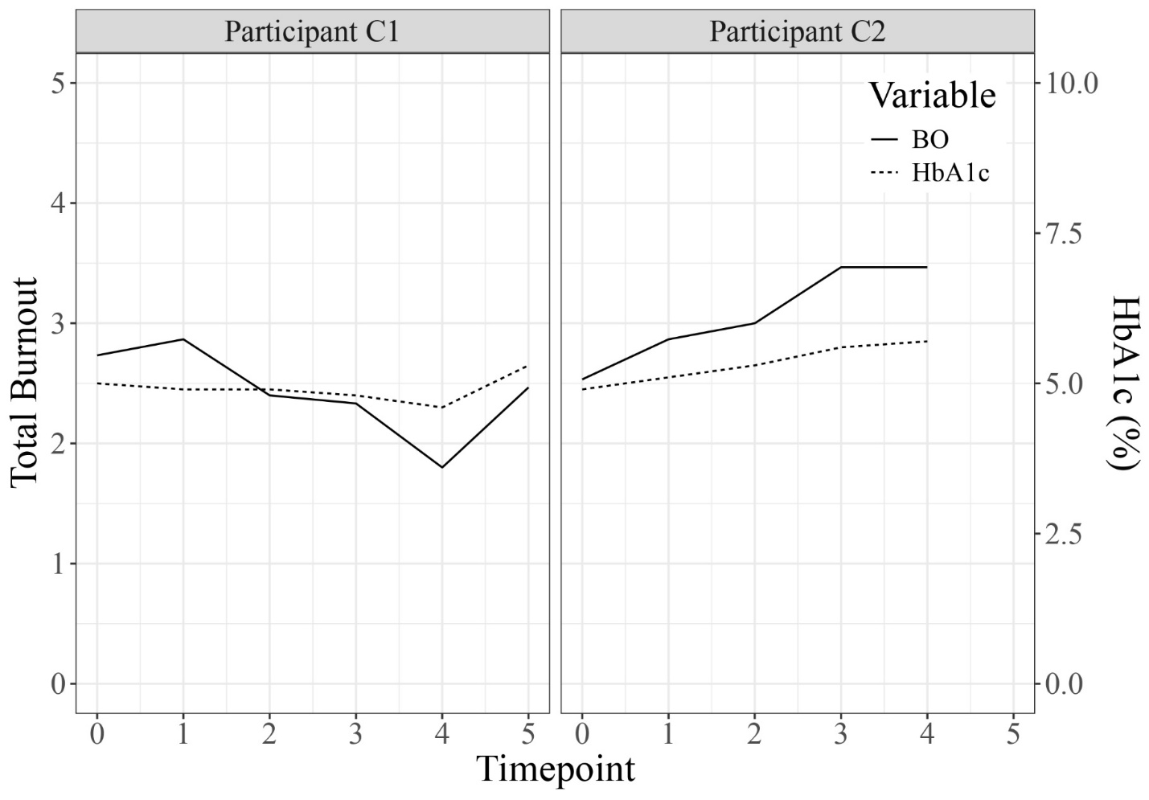
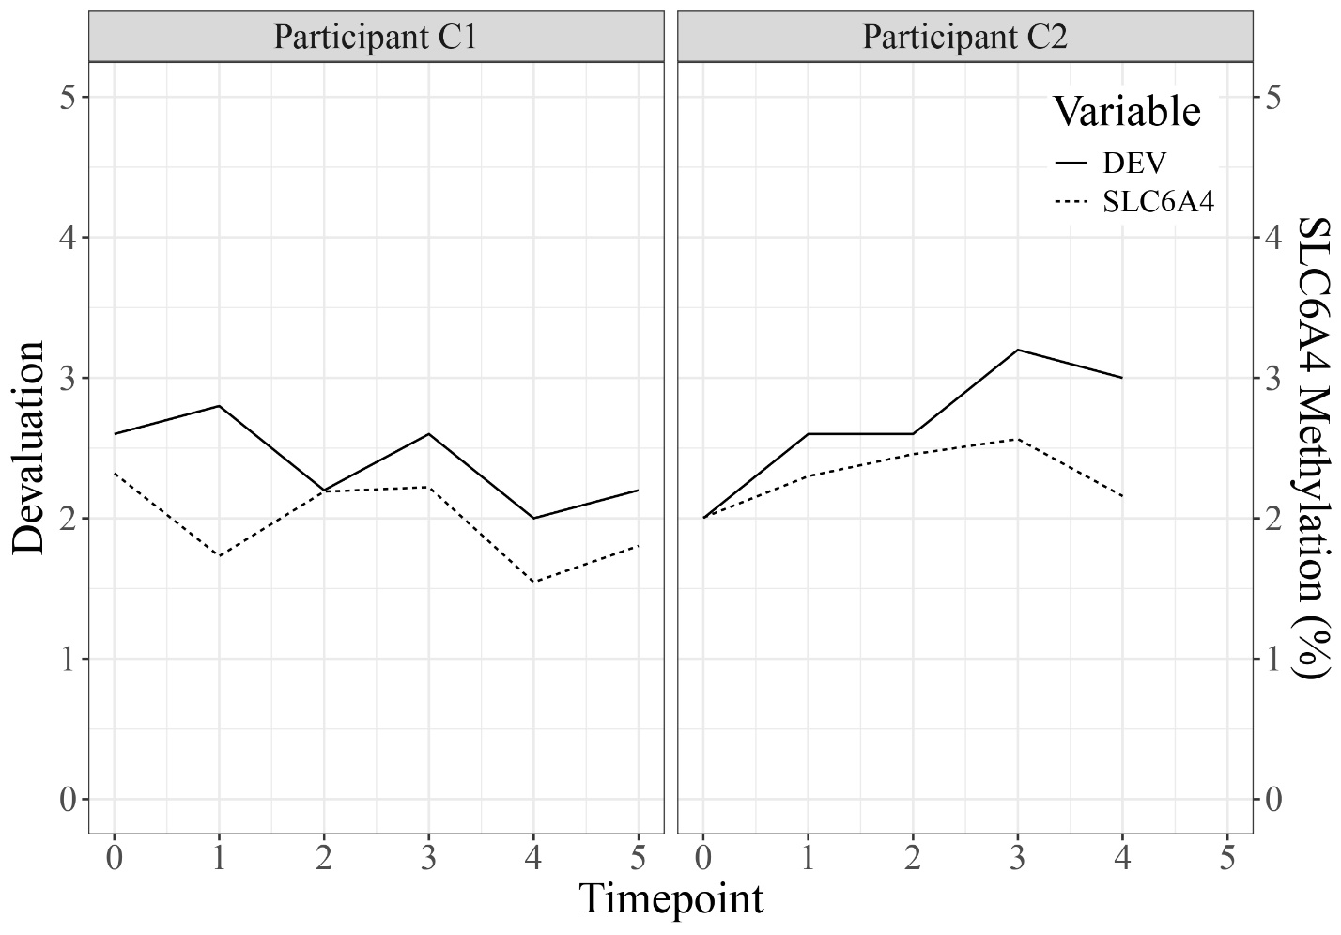
Does burnout have physiological effects?
Methods N-of-1 design (4 athletes) Athlete burnout (ABQ) Acute (6 months): SCortisol, testosterone, DHEA-S, IgA, CRP Chronic (12 months): HCortisol, HbA1c, lipids, DNA methylation | Results Dynamic regression model + visual analysis
Chronic
Acute
RSA Testosterone
DEV DHEA-S, IgA
-.56
-.98
-.94
Glandorf et al. (in prep)
Notes:
The direction from each biomarker back to burnout (for IgA and DHEA-S) was about half as strong as the forward direction.

Slide 7
Burnout impacts health
Cognitive appraisal
Psychological responses
(e.g., depression)
Multisystem dysfunction
(HPA axis, immune system, anabolic activity, cardiovascular system, nervous system)
Resources
(e.g. sleep, life satisfaction)
Allostatic overload
Demands
Smith’s (1986) cognitive-affective model of athlete burnout and McEwen & Stellar’s (1993) allostatic load theory

Slide 8

Questions

Slide 9
References
Glandorf, H. L., Madigan, D. J., Kavanagh, O., & Mallinson-Howard, S. H. (2023). Mental and physical health outcomes of burnout in athletes: A systematic review and meta-analysis. International Review of Sport and Exercise Psychology.
Advance online publication.
Glandorf, H. L., Madigan, D. J., Kavanagh, O., Mallinson-Howard, S. H., Donachie, T. C., Olsson, L. F., & Rumbold, J. L. (in press). Athlete burnout and mental and physical health: A three-wave longitudinal study of direct and reciprocal effects. Sport, Exercise, and Performance Psychology.
Glandorf, H. L., Madigan, D. J., Kavanagh, O., & Mallinson-Howard, S. H. (in prep). Mental and physical health outcomes of burnout in athletes: A systematic review and meta-analysis. Examining biomarkers of athlete burnout: An exploratory, longitudinal N-of-1 study.
McEwen, B., & Stellar, E. (1993). Stress and the Individual. Archives Of Internal Medicine, 153(18), 20-93.
Raedeke, T. D., & Smith, A. L. (2001). Development and preliminary validation of an athlete burnout measure. Journal of Sport and Exercise Psychology, 23, 281-306.
Smith, R. (1986). Toward a cognitive-affective model of athletic burnout. Journal of Sport Psychology, 8(1), 36-50.
World Health Organization. (2022). ICD-11: International classification of diseases (11th revision). https://icd.who.int/

