Slide 1
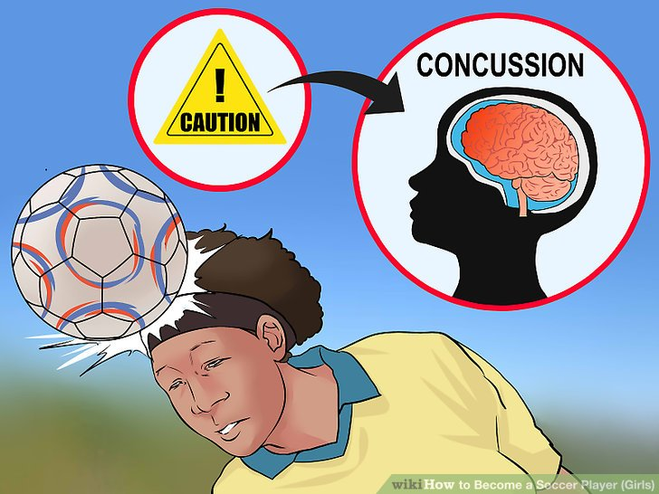

A Documentary Analysis of Head-related Policies in Professional Football
Bright Uzoramaka Nduka
York St John University

Slide 2

RESEARCH OBJECTIVES
This study explores the content of head-related policies in football, the extent of their application, as well as the impact of these policies on the health and welfare of young boys in professional football academies. It examines factors that have facilitated or impeded policy implementation and investigates how these policies have shaped the attitudes of these boys toward football.

Slide 3

A Documentary Review
The READ approach to document analysis was utilised (Dalglish et al., 2020).
Policy documents include:
The US Soccer Concussion policy
The English FA Youth Heading in Training Guidance
The Independent Review of Duty of Care
The FA Concussion Guidelines
The UK Concussion Guidelines for Grassroots Sport
The Scottish Sport Concussion Guidance

Slide 4

Theoretical framework
As a sociological study, this research employs the work of Norbert Elias (1987-1990) known as Figurational or Process Sociology.
Understanding the processual nature of the development and implementation of these policies
‘Civilising process’ – Elias’s main text exploring long-term bodily control and social etiquette – the sportization of sports
Figurations – Interdependent relationships in football and the heading policies.
Power Relations – An attribute of any social relationship that is always in a state of flux.

Slide 5

Preliminary findings
Underlying Foundational Matters
Unbalanced Focus of Policies
Speculative Nature of Policies
Implementation and Monitoring Strategies
Constraints to Policy effectiveness

Slide 6

Thank you

