Slide 1
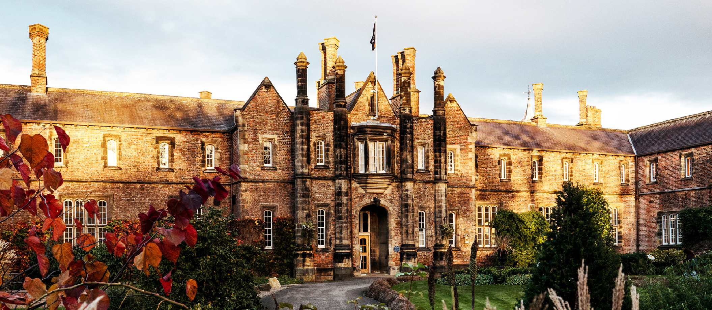
An Investigation on Employees’ Perspectives in Supporting Inclusion & Diversity among Neurodivergent Individuals: A Study on North Yorkshire Service Industry - Scoping Insights and Next Stage
Dr Hongrui Zhu and Dr Ruby Christine Mathew
York Business School, York St John University

Slide 2
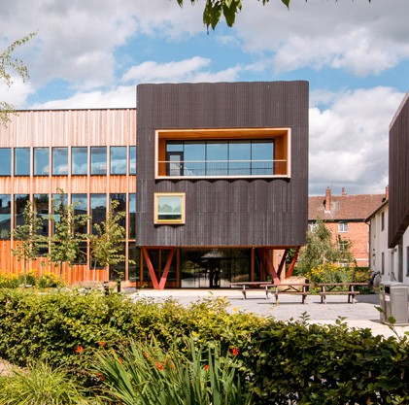
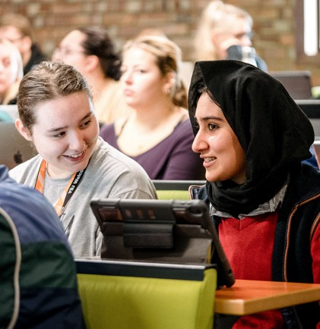
Research Context
15% of UK population is neurodivergent (Henley & Jordan, 2025)
Recent studies highlight the need for more accessible and inclusive travel experiences for individuals with physical and sensory conditions (Darcy et al., 2020; Liu et al., 2024)
However, limited research on how service staff are prepared to meet the needs of neurodivergent tourists (Jepson et al., 2024).

Slide 3
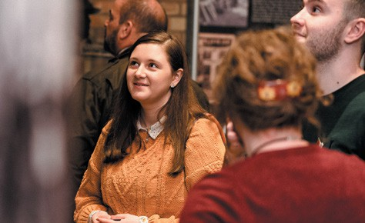
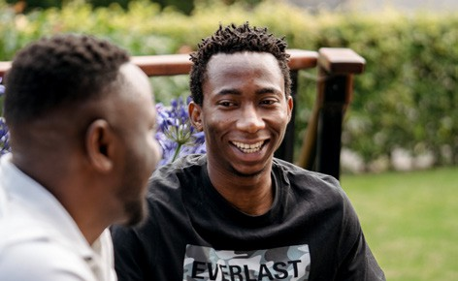
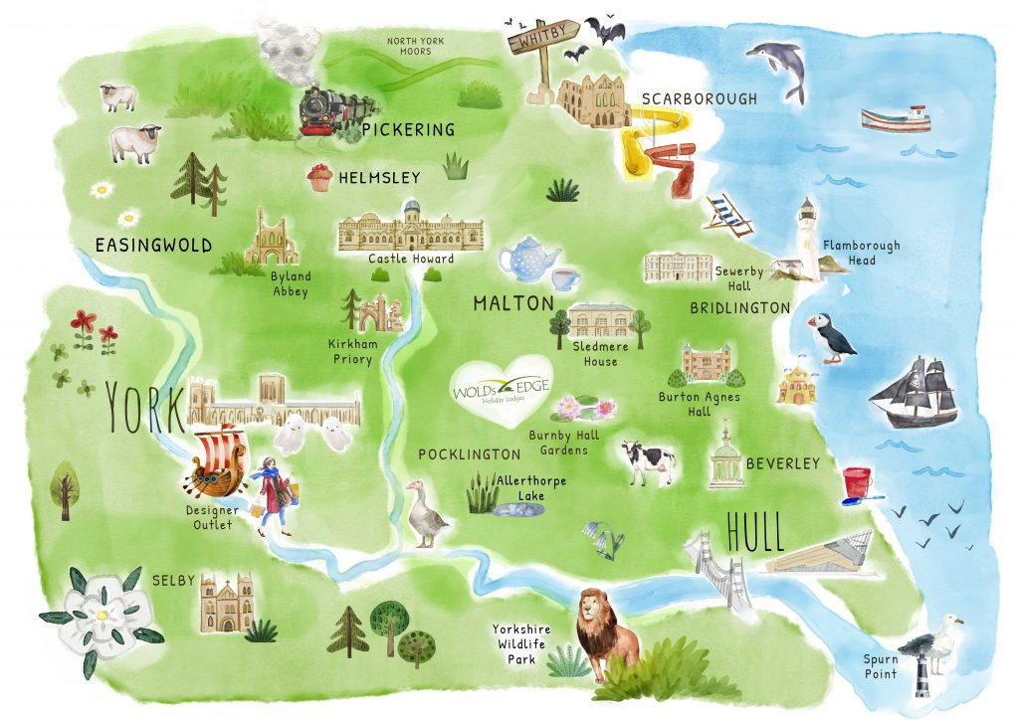
Why North Yorkshire?
The tourism industry in North Yorkshire is considered a major driver for economic contribution and job creation.
Increasing initiatives to address existing issues associated with sustainable tourism development and inclusive tourism.
(North Yorkshire Council, 2023)
https://woldsedge.co.uk/things-to-do/local-attractions

Slide 4
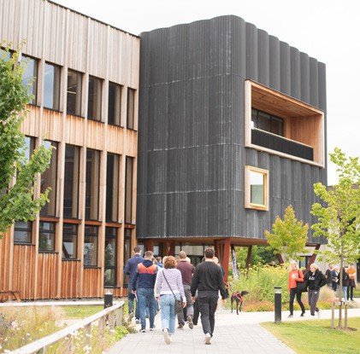
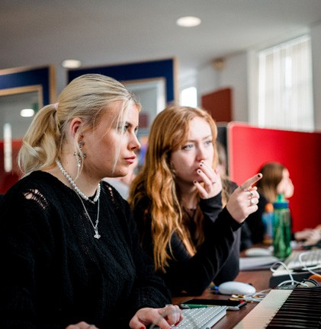
Framing the Study: Neurodiversity & Inclusion
Neurodiversity = natural variation (Jaarsma & Welin, 2012), recognising diverse ways of engaging with the world (Baumer & Frueh, 2021)
Not a disorder to be fixed, but diversity to be accommodated (Jepson et al., 2024)
Social model: environment must adapt to individual needs, involves a shared responsibility between individuals, organisations, and society.
Inclusion linked to dignity, accessibility, human rights.

Slide 5
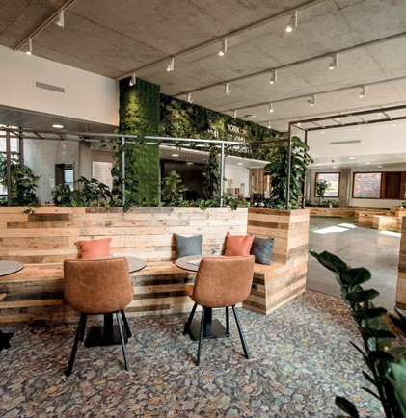
Research Aim and Objectives
The aim of this research is to examine the awareness and preparedness of employees in tourism, hospitality, and leisure organisations in North Yorkshire to deliver positive services and experiences for neurodivergent individuals and their families.
Specifically, it seeks to:
To examine how frontline staff understand the concept of neurodiversity and its relevance to guest service.
To assess the extent to which organisations have implemented policies, training, or practices that support neurodivergent visitors.
To identify perceived barriers and challenges that employees face in providing accessible and inclusive services for neurodivergent individuals and their families.

Slide 6
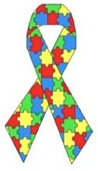
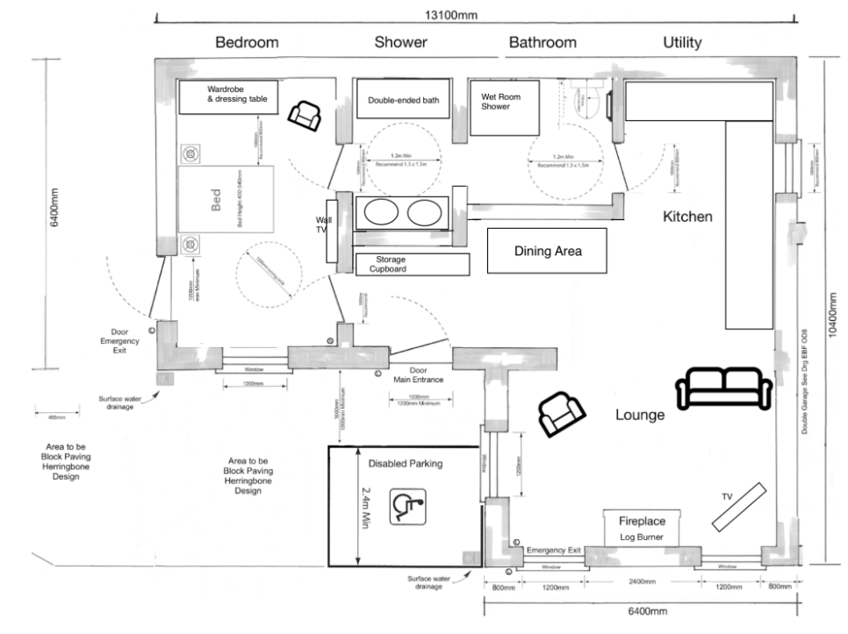
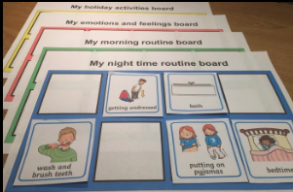
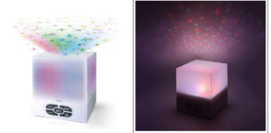
Inclusive Practices in North Yorkshire
Cottage in the Dales - The Dairy (n.d.)
By working with families, staff offer personalised service informed by autism awareness training.
JORVIK Group (JORVIK Viking Centre, The DIG and Barley Hall)
All staff have received Autism Awareness training.
Use of Recite Me, a website accessibility toolbar that allows website visitors to customise a site in a way that works best for them.
Visual stories, quiet sessions, traffic-light badges for sensory regulation (JORVIK Viking Centre, n.d.)
York Museum Trust (York Castle Museum, York Art Gallery and Yorkshire Museum)
Autism-inclusive training mentioned at organisational level.
Sensory basket to borrow at York Castle Museum (York Castle Museum, n.d.).
Video Tour & Sensory Story
The Floor Plan
Choice Board & Star Projector
Sources: https://www.cottageinthedales.co.uk/holiday-cottages/95/Autism-Friendly?utm.com

Slide 7
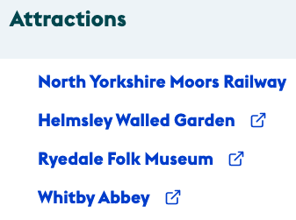
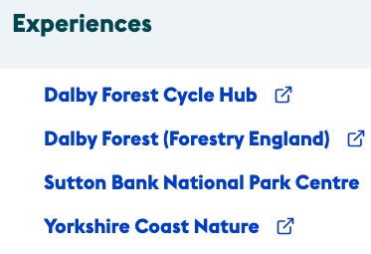
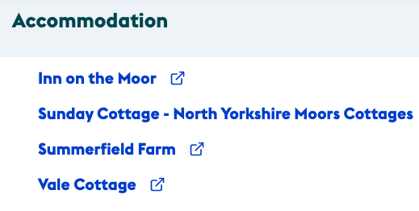
Regional Gaps in Supporting Neurodivergent Visitors
Narrow Accessibility Framing
Accessibility efforts often focus on physical mobility and sensory impairments, with neurodivergence receiving little explicit attention (e.g., North York Moors Accessibility Project in 2021).
Ambiguity in Staff Training
While organisations mention autism awareness training, details on staff preparedness remain unclear.
Intra-organisational Inconsistency
Variations across York Museum Trust sites despite shared governance.
Policy-Practice Disconnect
Although accessibility features are provided (e.g., by some hotels), there appears to be limited mention of staff training or service adaptations tailored for neurodivergent guests.
Notes:
12 business from accommodation, attractions and experiences.
Many staff York Castle /some art gallery/no Yorkshire museum have received autism-inclusive training.

Slide 8
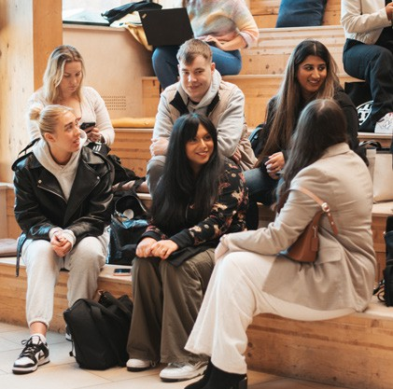
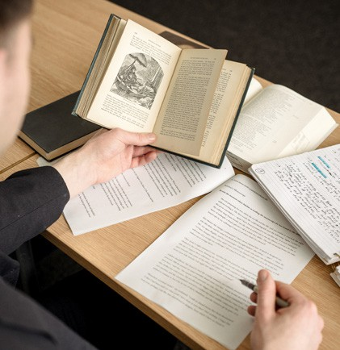
Towards the Next Stage: Empirical Phase
These issues and variations in practice, both within and across organisations, highlight the need for further investigation into how neurodivergent visitors are supported in North Yorkshire.
The next stage of this research will therefore involve a qualitative study grounded in the interpretive paradigm. These insights will shape sampling strategy, focusing on organisations identified during the scoping.
Semi-structured interviews serve as the primary data collection method, allowing for in-depth exploration, followed by thematic analysis using NVivo 12.
Notes:
Based on our scoping analysis, the study aims to explore staff awareness, preparedness, and the challenges they face in supporting neurodivergent guests in the tourism sector.

Slide 9
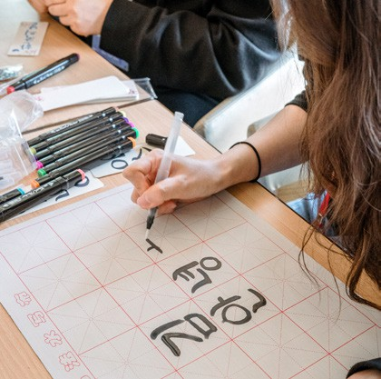
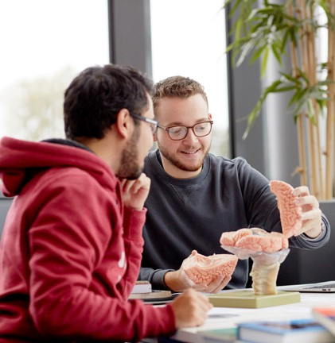
Significance of the Research
Understanding employees’ perspectives in the service industry is an important step toward better supporting neurodivergent tourists.
The planned study will identify the challenges employees face when supporting neurodivergent guests.
The findings aim to contribute to academic discussions on neurodiversity inclusion in tourism/hospitality/leisure and provide practical implications for industry practitioners.
Notes:
Ultimately, this research seeks to support the tourism industry to create more inclusive experiences for neurodivergent guests.

Slide 10
Source: https://medium.com/sales-world/not-just-thank-you-slide-205961b01b96

Slide 11
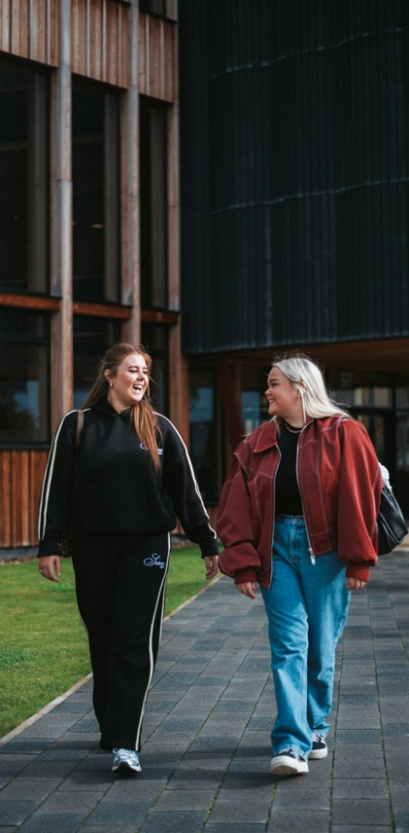
Bibliography
Baumer N., & Frueh, J. (2021) What is neurodiversity? Retrieved from https://www.health.harvard.edu/blog/what-is-neurodiversity-202111232645 (Accessed 17 January 2025).
Cottage in the Dales - The Dairy (n.d.) Inclusive Luxury. Retrieved from https://www.cottageinthedales.co.uk/holiday-cottages/95/Autism-Friendly?utm.com (Accessed: 02 July 2025).
Darcy, S., McKercher, B., & Schweinsberg, S. (2020). From tourism and disability to accessible tourism: A perspective article. Tourism Review, 75(1), 140-144. https://doi.org/10.1108/TR-07-2019-0323
Henley, R. & Jordan, J. (2025) Neurodiversity, Local Government Association. Retrieved from https://www.local.gov.uk/lga-libdem-group/our-press releases/neurodiversity#:~:text=However%20it%20is%20estimated%20that%20around%20one,brain%20functions%2C%20learns%20and%20processes%20information%20differently.&text=According%20to%20the%20British%20Dyslexia%20Association%2C%20the,the%20severe%20end%20of%20the%20dyslexia%20continuum. (Accessed: 08 June 2025).
Jaarsma, P. & Welin, S. (2012). Autism as a natural human variation: Reflections on the claims of the neurodiversity movement. Health care analysis, 20, pp.20-30.
Jepson, A., Stadler, R., & Garrod, B. (2024). Tourism and neurodiversity: A problematisation and research agenda. Current Issues in Tourism, 27(4), 546-566. https://doi.org/10.1080/13683500.2023.2233040.
JORVIK Viking Centre. (n.d.) Access. Retrieved from https://www.jorvikvikingcentre.co.uk/visit/access/ (Accessed: 04 July 2025).
Liu, A., Ma, E., Wang, Y. C., Xu, S., & Grillo, T. (2024). AI and supportive technology experiences of customers with visual impairments in hotel, restaurant, and travel contexts. International Journal of Contemporary Hospitality Management, 36(1), 274-291. https://doi.org/10.1108/IJCHM-10-2022-1243.
North Yorkshire Council (2023) Economic growth strategy 2024-2029 appendices.pdf, North Yorkshire Council Economic Growth Strategy 2024-2029. Available at: https://edemocracy.northyorks.gov.uk/documents/s23675/Economic%20Growth%20Strategy%202024-2029%20Appendices.pdf (Accessed: 08 June 2025).
VisitBritain. (n.d.). North York Moors Accessibility Project. Retrieved from https://www.visitbritain.org/business-advice/make-your-business-accessible-and-inclusive/north-york-moors-accessibility-project (Accessed: 02 July 2025).
York Art Gallery. (n.d.). Access. Retrieved from https://www.yorkartgallery.org.uk/access/ (Accessed: 04 July 2025)
York Castle Museum. (n.d.). Access. Retrieved from https://www.yorkcastlemuseum.org.uk/access/ (Accessed: 04 July 2025)
Yorkshire Museum. (n.d.). Access. Retrieved from: https://www.yorkshiremuseum.org.uk/access/ (Accessed: 04 July 2025)

