Slide 1


Language, Sexuality and Inclusive Pedagogy
Helen Sauntson
York St John University, UK
h.sauntson@yorksj.ac.uk
https://www.yorksj.ac.uk/research/centre-for-language-and-social-justice-research
Language Education for Social Justice
University of Jyvaskyla, June 2021
Notes:
30 minutes

Slide 2
Language and inclusion in education
Motschenbacher (2011; 2016) – need for greater examination of concepts of ‘social justice’ and ‘inclusion’ from a linguistic perspective.
Linguistic research - well-placed to offer insights into how to develop and implement sexuality-inclusive language education.
Linguistic injustices are not just about language – they also relate to social dimensions such as gender and sexuality.

Slide 3

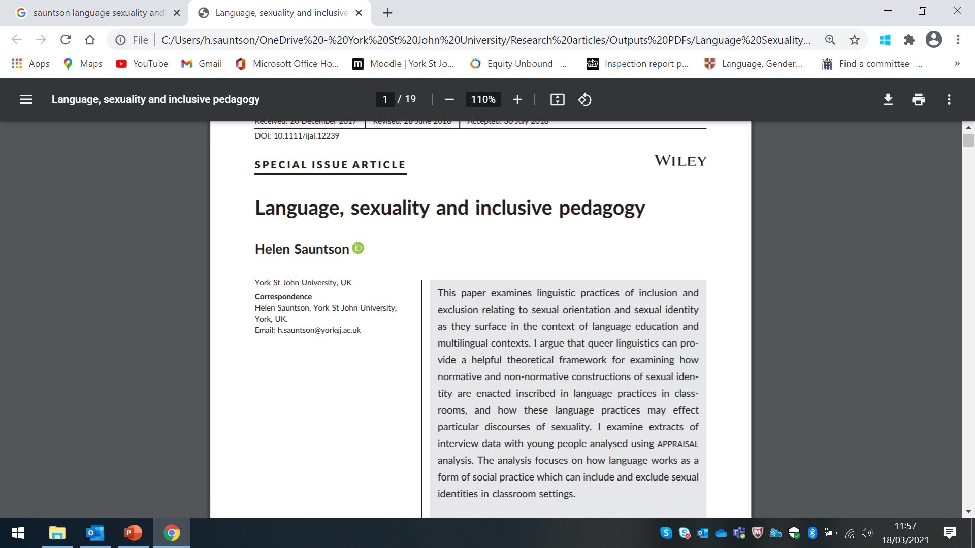
Language, sexuality and educational inclusion
Language and sexuality in educational contexts – key areas of research:
ESL classrooms and foreign and second language education (e.g. Ellwood, 2006; Liddicoat, 2009; Nelson, 2006; 2012; O’Mochain, 2006; Paiz, 2020; Paiz and Coda, forthcoming)
Foreign language textbooks and other learning materials (e.g. Goldstein, 2015; Gray, 2013; Pakula et al, 2015; Pawelczyk and Pakula, 2015; Sunderland, 2015)
Language and production of sexuality and in/exclusionary discourses in UK schools (Sauntson, 2018a; 2018b, 2019)

Slide 4
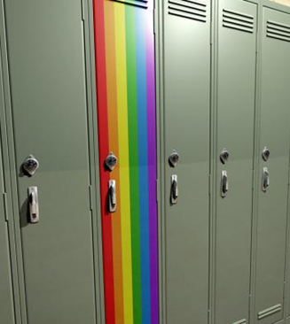
Queer linguistics
Useful for examining how normative and non-normative constructions of gender and sexual identity are inscribed in specific language practices in schools, and how these language practices may effect particular discourses of gender and sexuality.
Can use different linguistic analytical frameworks within an overarching queer linguistics approach to examine how heterosexuality is naturalised through language and how other forms of sexual and gender identity are ‘queered’
Motschenbacher (2011) and Motschenbacher & Stegu (2013) – queer linguistics lends itself well to an eclectic combination of linguistic analytical frameworks in order to provide mutually qualifying positions.

Slide 5

Data and methods of analysis
Interviews (x 20) with LGBT+-identified young people (aged 13-25) who attend or have recently attended schools and colleges in two UK cities
Appraisal analysis (Martin, 2000; Martin & White, 2005) used within overarching queer linguistic approach

Slide 6
Appraisal analysis
Appraisal provides a systematic framework for analysing and describing evaluative language and categorising the ways that feelings, emotions, attitudes, social relationships and experiences are encoded in language.
appraisal is used to explore how language embodies the young people’s feelings, attitudes and values towards sexual diversity and issues of inclusion and exclusion in schools, and how they perceive normative gender and sexualities to be constructed and reinforced in schools

Slide 7
Appraisal –Overview
APPRAISAL consists of the systems of:
ATTITUDE
GRADUATION
ENGAGEMENT
ATTITUDE = primary system through which people express emotions, judgements and values

Slide 8
3 subsystems of attitude
Affect – the linguistic resources deployed for construing the individual’s emotional responses;
Judgement – the linguistic resources deployed for construing moral or social evaluations of behaviour;
Appreciation – the linguistic resources deployed for construing the ‘aesthetic’ qualities of processes and natural phenomena.
Each of the categories can have a positive or a negative value and the values work on a sliding scale of graduation.
Appraisal markers are realised primarily through the lexico-grammar of a text.

Slide 9
Attitude examples
Affect:
it’s sort of discomforting when they’re saying you have sex with a woman and that’s the end of it (insecurity)
over the summer I’d been feeling really bad (unhappiness)
Judgement:
they don’t really get that it’s part of their job (-capacity)
I didn’t say anything to any of the teachers (-veracity)
Appreciation:
this kind of was a positive story (+valuation)
it’s just a waste of effort and money and stuff and we’re not actually learning what we need to learn (-valuation)

Slide 10
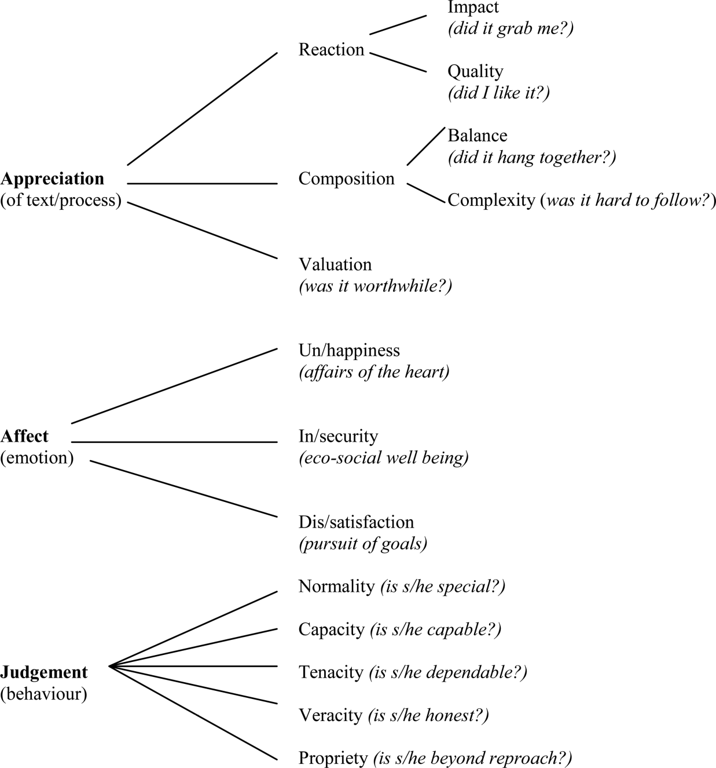

Slide 11
Affect: Sub-categories
Positive affect | Negative affect
Inclination (expresses feelings of desire) | Disinclination (expresses feelings of fear)
Happiness (expresses feelings of cheerfulness and affection) | Unhappiness (expresses feelings of misery and antipathy)
Security (expresses feelings of confidence and trust) | Insecurity (expresses feelings of disquiet and surprise)
Satisfaction (expresses feelings of interest and admiration) | Dissatisfaction (expresses feelings of ennui and displeasure)

Slide 12
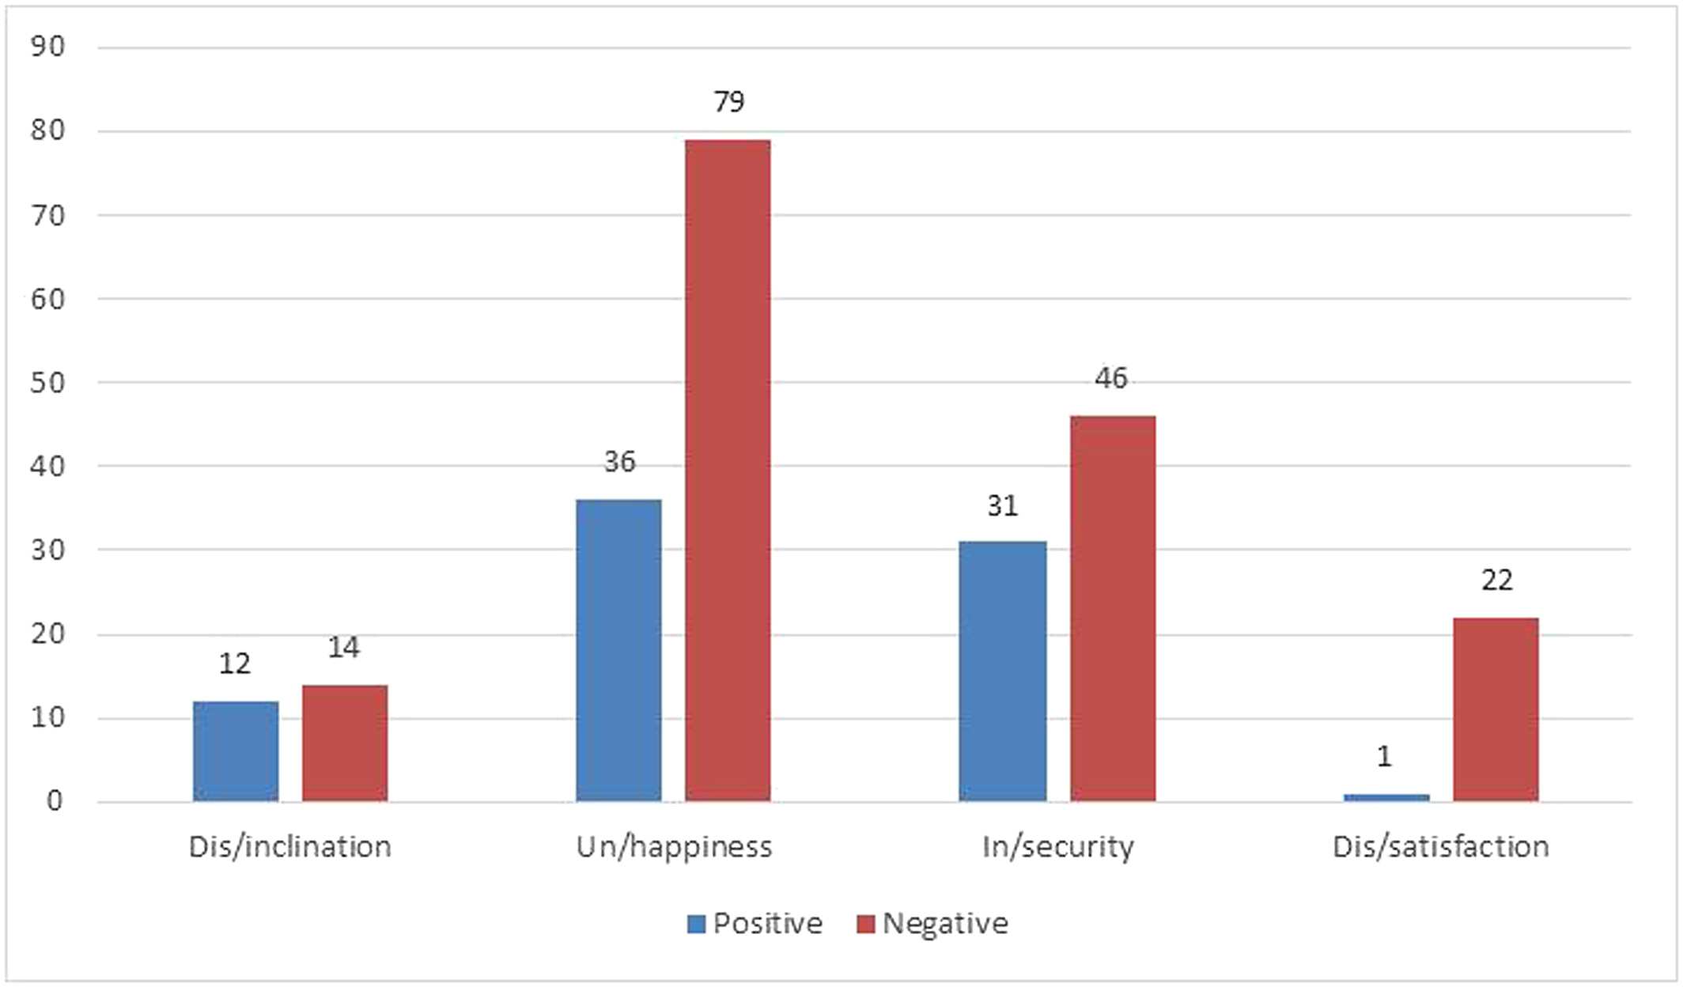
Analysis: Affect (evaluation of own feelings)

Slide 13
Analysis: Affect examples (unhappiness - Self)
Ashley: I’ve always had sort of really terrible anxiety and depression and gradually feelings got worse and worse
Fay: I hated school I used to do whatever I wanted to get away from it was that bad
Josh: screaming on the inside like I'm not happy at this school I'm getting bullied
Martin: I had loads of problems at school […] it was just awful for me

Slide 14
Analysis: Affect examples (insecurity - Self)
Amy: it probably didn’t help that I wasn't comfortable with the label either
Ashley: there was a dress code and I had to abide by that and all of that made me feel very uncomfortable
Ashley: it would be just very confrontational in a way that sort of made me very anxious gave me sort of panic attacks
John: I got that all the time as well as the dirty looks that make you feel uncomfortable
Josh: it's just sort of discomforting when they’re saying when you have sex with a woman and that's the end of it
Abby: I remember this relationship I had with this one girl and like I was terrified she’d like use it if we’d fall out I don’t know why it’d bother me but if we’d fall out she’d be like I’m going to tell everyone and stuff I would be absolutely terrified I would like have nightmares I wouldn’t be able to sleep for weeks

Slide 15
Analysis: Affect examples (security - Self)
Ashford: my teacher that I trust the most that I went to about being trans he is one of the most progressive people in the entire school
Tad: luckily I had in the school which I was being bullied in a teacher who was gay and she worked with physical education and she made it more comfortable for me to even be in that environment in fact she did something really remarkable as I was so uncomfortable with the boys in their changing room […] I was removed from PE but I wanted to join in with something different I loved hanging around with girls then because that's when I felt more comfortable

Slide 16
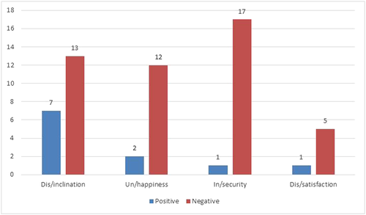
Analysis: Affect (evaluation of others’ feelings)

Slide 17
Analysis: Affect examples (others)
Fay: there could be kids out there like “I like this what does that make me” something like that if they’re like struggling (unhappiness) to know who they are
Jack: there's seven people in that class that are thinking ’oh shit’ (insecurity) right now
Dan: the only trans we have in the school which is quite I’ve talked to him and he was like saying he found it really hard (unhappiness) when he came cos he was the only one and he found it really hard (unhappiness)

Slide 18
Analysis: Affect examples (others)
Hannah: I think a lot of teachers are scared (insecurity) to bring it up
Josh: Miss was very shocked (insecurity) when I wrote about a gay teen suicide of Jamie Rodemeyer

Slide 19

Judgement
Social esteem – Assesses institutions, individuals and behaviours in terms of their: normality (how usual/unusual they are), capacity (how capable they are) and tenacity (how determined or resolute they are). Social esteem markers provide evaluations of how behaviour conforms or does not conform to socially desirable standards.
Social sanction – Assesses institutions, individuals and behaviours veracity (how truthful they are) and propriety (how ethical they are) and provides evaluative markers which indicate whether a behaviour is seen as right or wrong.
(Based on Martin, 2000)

Slide 20
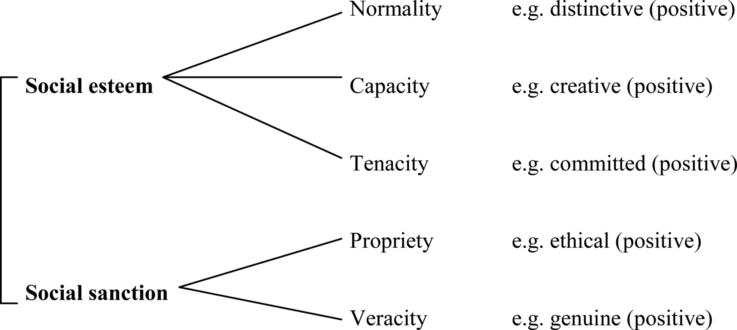
Judgement

Slide 21
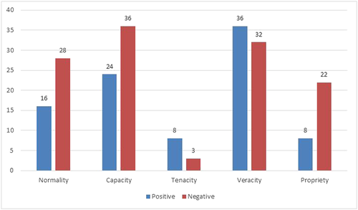
Analysis: Judgement (evaluation of own behaviour)

Slide 22
Analysis: Judgement examples (veracity – Self)
Amy: you don’t wanna say that to anybody so it was keep it quiet it’ll go away keep it quiet it’ll go away (−veracity) kind of a feeling for me […] if I just carry on and just keep doing my work and stop playing football and say “yea I like that boy in the magazine” try and conform (−veracity) that it’ll all be just go away
Ashley: I came out in secondary school I was very open (+veracity) about being trans I came out about 16 so both the school and pretty much all of the students knew about it (+veracity)
Jack: I didn’t come out (−veracity) at school just because it was quite homophobic and well especially in a Catholic school when it's always depicted as being wrong in RE and stuff so I weren’t willing to do it so I kept it to myself (−veracity)
Stephen: I kind of came out (+veracity) slowly to my teachers like I told my SEN worker then they had a meeting with all the staff
Abby: I’m still not out (−veracity) in that area because it's just not spoken about

Slide 23
Analysis: Judgement examples (capacity – self)
Fay: I didn’t know (−capacity) what a lesbian was I only thought there was gays and bis I didn’t even know (−capacity) there was a lesbian until I met that guy he told me about lesbians and transsexuals and hermaphrodites and loads of other areas but until I met him I didn’t know (−capacity)
Jack: when I was young I was thinking “I’m never gonna be able to (−capacity) come out” just couldn’t (−capacity) get on with my life just be pretending

Slide 24
Analysis: Judgement examples (normality and propriety – self)
    Fay: I’ve had comments about being a dyke being a weirdo being a freak (−normality)
    John: I wasn’t like out or anything like that but I still got like “you poof” and all crap like that (−normality)
    Josh: I’ve moved nearly every single time because of bullying just like being the odd one out never really fit in (−normality)
    Abby: the girls didn’t have to wear ties and they wore like the feminine v‐tops which I hated but we weren’t allowed to wear ties (−propriety) until the last year because it was you know in a grammar school it's like boys and girls there's no in between or anything
    Nicky: it's almost like if you’re the first one to come out and be gay or dress differently you’re the one that's going to be made an example of (−propriety) […] it's like being gay and kind of like dressing gay is on another level so you don’t wanna kind of bring attention to yourself

Slide 25
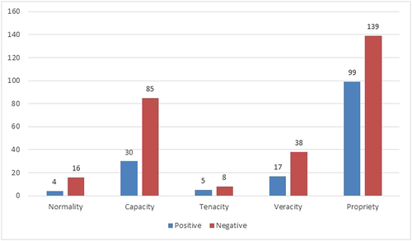
Analysis: Judgement (evaluation of others’ behaviour)

Slide 26
Analysis: Judgement examples (propriety - others)
Ashford: the entire class is just really transphobic (−propriety) and it's just not a very nice atmosphere and the teachers almost laugh along with it (−propriety)
Ashley: no‐one has really said anything awful to me about my gender or sexuality everyone's been kind of accepting (+propriety)
Carl: every time we had an assembly if there was an award ceremony and he had to go up and get a certificate or anything they’d all shout out hide your arse or watch your arse something like that (−propriety)
Fay: they like treated me with respect (+propriety) they didn’t treat me like I was different
Nicky: there was an out lesbian couple and as soon as everyone found out about them people refused to get changed in the same changing room at PE and no teacher ever did anything about it (−propriety)
Stephen: my English teacher's like she's really supportive of it and she's always on about treating people equally no matter what the sexuality or what the sexual identity is (+propriety)
Ashley: the first person I came out to at school was a teacher and was the head of the English department […] he was completely accepting of it (+propriety) I sort of came to him in a distraught mess and he was just great (+propriety)

Slide 27
Analysis: Judgement examples (-capacity – others)
Ashford: they were talking about friends and relationships and all that in French and in his paragraph he put down boyfriend and he keeps doing it to see how many times it's corrected to girlfriend and right now it's been seven times he's been corrected from boyfriend to girlfriend in French
Jason: I actually think it's been quite poorly handled (−capacity) in my experience they never really sit you down and talk to you about it they sort of just push it aside and sweep it under the mat (−capacity)
Ruby: schools just like it's not really their problem it's like something personal that they have to deal with and they don’t really get that it's part of their job (−capacity) it's like literally your job
Stephen: teachers have to be better educated (−capacity)
Nicky: I just go back to they need to be educated better (−capacity)

Slide 28
Analysis: Judgement examples (-veracity – others)
Alex: didn’t even mention it (−veracity) anything like that
John: when I was at school it was never spoke about (−veracity)
Jason: that's all just like shoved under the carpet and ignored (−veracity)
Todd: they were silent on it they didn’t really talk about it (−veracity)

Slide 29
Appreciation (from Martin, 2000)
 | Positive | Negative
Reaction: Impact ‘Did it grab me?’ | arresting, captivating, engaging... fascinating, exciting, moving... | dull, boring, tedious, staid... dry, ascetic, uninviting...
Reaction: Quality ‘Did I like it?’ | lovely, beautiful, splendid... appealing, enchanting, welcome... | plain, ugly... repulsive, revolting...
Composition: Balance ‘Did it hang together?’ | balanced, harmonious, unified... symmetrical, proportional... | unbalanced, discordant... contorted, distorted...
Composition: Complexity ‘Was it hard to follow?’ | simple, elegant... intricate, rich, detailed, precise... | ornamental, extravagant... monolithic, simplistic...
Valuation ‘Was it worthwhile?’ | challenging, profound, deep... innovative, original, unique... | shallow, insignificant... conservative, reactionary...

Slide 30
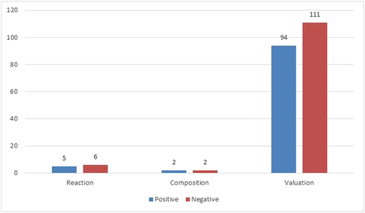
Analysis: Appreciation

Slide 31
Analysis: Appreciation
+Valuation (facilitators of inclusion) | -Valuation (barriers to inclusion)
English | Sex and Relationships Education
Being involved in women’s and/or LGBT organisations | School’s treatment of homophobic bullies
Books with gay characters | Physical Education
Drama | Playground
Discussions about LGBT identities, relationships and issues | School’s handling of gender issues/gender segregation
Music | Exams
Art | School uniform policy
Items ascribed positive and negative valuation

Slide 32
Appreciation: Examples (-valuation)
Alex: I don’t think there was any positive (−valuation) in my school it's just nothing it was mostly negative (−valuation)
Hannah: I just don’t think there was any support at all (−valuation) in our school
Martin: overall I think it [school bullying policy] was ineffective (−valuation)
Ashford: another thing that schools need to change is segregating or like putting people in different things because of their gender (−valuation) […] girls’ changing room right next to it they’re on completely different sides of the school and even our PE lessons are quite often segregated which is ridiculous (−valuation)

Slide 33
Appreciation: Examples (+valuation)
Amy: I think English is perhaps the best subject (+valuation) to introduce it through […] it's a good way of maybe celebrating differences so I think it’d be a perfect subject (+valuation)
Carl: when I done Drama that was okay that was good (+valuation) I had a nice teacher

Slide 34
Summary of key findings
Participants experience more exclusion than inclusion
Teachers seen as being at the heart of inclusive pedagogy around sexuality and gender diversity. Seen to have capacity to create inclusive or exclusionary learning environments in relation to gender and sexual diversity.
Teachers thus play an important role as guardians of inclusive language policies, as shapers of communicative norms in the classroom community and as ‘agents of change’ more generally. (Motschenbacher, 2011: 180)
The subject of English emerges as having transformative potential and is recognised by participants as a key site for establishing and developing socially just and inclusive pedagogy in relation to gender and sexual diversity.

Slide 35
Implications and ways forward
Need issues of language, sexuality and inclusion to form an integral part of teachers’ pre-service and in-service training
School inclusion policies need to contain focus on language issues (which consider linguistic silence as well as linguistic presence)
English teachers play particularly important role in gender and sexual diversity training in schools

Slide 36
References
Ellwood, C. (2006) On coming out and coming undone: Sexualities and reflexivities in language education research. Journal of Language, Identity, and Education 5 (1): 67-84.
Goldstein, B. (2015) LGBT invisibility in language learning materials. Seminar 5 of Queering ESOL: Towards A Cultural Politics of LGBT Issues in the ESOL Classroom.
Gray, J. (ed) (2013) Critical Perspectives on Language Learning Materials. Basingstoke: Palgrave.
Leap, W. (2020) Language Before Stonewall: Language, Sexuality, History. Basingstoke: Palgrave.
Liddicoat, A. (2009) Sexual identity as linguistic failure: Trajectories of interaction in the heteronormative language classroom. Journal of Language, Identity and Education 8 (2/3): 191-202.
Martin, J. (2000) Beyond exchange: APPRAISAL systems in English. In S. Hunston and G. Thompson (eds) Evaluation in Text: Authorial Stance and the Construction of Discourse. Oxford: Oxford University Press. 142-175.
Martin, J. and White, P. (2005) The Language of Evaluation: Appraisal in English. Basingstoke: Palgrave.
Motschenbacher, H. (2011) Taking queer linguistics further: Sociolinguistics and critical heteronormativity research. International Journal of the Sociology of Language 212: 149-79.
Motschenbacher, H. (2016) Inclusion and foreign language education. International Journal of Applied Linguistics 167 (2): 159-189.
Motschenbacher, H. and Stegu, M. (2013) Queer linguistic approaches to discourse: Introduction. Discourse and Society 24 (5): 519-35.
Nelson, C. (2006) Queer inquiry in language education. Journal of Language, Identity and Education 5 (1): 51-66.

Slide 37
References
Nelson, C. (2012) Emerging queer epistemologies in studies of ‘gay’-student discourses. Journal of Language and Sexuality 1 (1): 79-105.
O’Mochain, R. (2006) Discussing gender and sexuality in a context-appropriate way: Queer narratives in an EFL college classroom in Japan. Journal of Language, Identity and Education 5 (1): 51-66.
Paiz, J. (2020) Queering the English Language Classroom: A Practical Guide for Teachers. London: Equinox.
Paiz, J. and Coda, J. (eds) (Forthcoming) Intersectional Perspectives on LGBTQ+ Issues in Modern Language Teaching and Learning. Basingstoke: Palgrave.
Pakula, L., Pawelczyk, J. and Sunderland, J. (2015) Gender and Sexuality in English Language Education: Focus on Poland. London: British Council.
Pawelczyk, J. & Pakula, L. (2015) Constructing gender and sexuality in the EFL classroom in Poland: Textbook construction and classroom negotiation? In A. Mustapha & S. Mills (eds) Gender Representation in Learning Materials: International Perspectives. London: Routledge. 193-211.
Sauntson, H. (2018a) Language, Sexuality and Education. Cambridge: Cambridge University Press.
Sauntson, H. (2018b) Language, sexuality and inclusive pedagogy. Special issue on ‘Linguistic dimensions of inclusion in foreign language education’. International Journal of Applied Linguistics.
Sauntson, H. (2019) Challenging gender- and sexuality-based discrimination in UK schools: Young women’s experiences of illegitimation and resistance. In J.I Kjaran and H. Sauntson (eds) Schools as Queer Transformative Spaces: Global Narratives on Sexualities and Genders. London: Routledge.
Sunderland, J. (2015) Gender (representation) in foreign language textbooks: Avoiding pitfalls and moving on. In S. Mustapha & S. Mills (eds) Gender Representations in Learning Materials: International Perspectives. London: Routledge. 19-34.

