Slide 1
Re-imagining the assessment of school-based practice
Keither Parker, Katy Bloom and Caroline Elbra-Ramsay

Slide 2
Learning Outcomes
Reflect on the nature of student autonomy, independent learning and developing as self-regulatory learners;
Gain an understanding of how school-based criteria can be used to create authentic assessment opportunities;
Consider how collaboration with partners supports co-creation rather than participation.

Slide 3
The Context of Initial Teacher Education (ITE)
ITE programmes are both academic and professional
Programmes are underpinned by partnership and collaboration
Assessment of academic modules and work-based practice
Current use of NASBTT grading guidance developed nationally for the sector
Notes:
KP –brief context

Slide 4
Changing ITE Context
The landscape of ITE has changed....and is continuing to change
Publication/introduction of the Core Content Framework for all ITE with compliance from September 2020 – impact on both academic and work-based practice (dichotomy of Learn That and Learn How To)
Publication/introduction of new Ofsted framework September 2020 underpinned by shift to non–grading of work-based placements.

Slide 5
Impact on ITE
Intense review of current curriculum offer
Development of subject/curriculum leads
Review of assessment of work-based practice
- a shift from grading to a new, innovative model
- capitalising on partnerships to secure collaboration of stakeholders

Slide 6
What does the research tell us?
In re-imagining what the ‘grade-less evaluations’ could look like, we had to consider several foci from education literature:
Consistent use of student-owned success criteria relating to classroom practice
The impact that grades/grades with feedback/feedback only has on student learning
Use of feedback that enabled the student to reflect and evaluate their own progress
Use of feedback which enabled them to consider and own their next steps: feedback that was contingent (consequential) and self-regulatory

Slide 7
Success criteria
Just having success criteria is not enough; it is what is done with them that matters.
“both [teachers and students] agreed on the usefulness of LIs and SC, in practice they were rarely discussed in class” (Chrichton & McDaid, 2016:190)
Without clear learning intentions and success criteria, the focus of feedback, from any direction, is likely to be more general, less specific, less helpful in celebrating success and suggesting improvement (Hattie and Clark, 2019:25)
“success criteria are simply a breakdown of the learning intention and provide a benchmark for the quality of the learning” (Hattie and Clark, 2019:70)

Slide 8
The argument against grading
The recognition of formative feedback trumping ‘grades’ judgements has a long record in educational research and practice. Seminal studies include:​
Elawar & Corno (1985) – students receiving constructive feedback had 50% gain on a control group receiving only grades​
Butler (1987, 1988) – 30% gain in classes receiving formative feedback only compared to feedback and grades, and grades only.​
Kohn (1994) – “Never grade students while they are still learning. They will stop learning as soon as they get their grade”​
Wiliam (2011) discusses a range of similar studies and the effect on student outcomes​
Carless (2015) emphasised a model of learning-oriented assessment focuses on three interrelated processes: the assessment tasks which students undertake; students’ development of self-evaluative capacities; and student engagement with feedback​
Winstone & Boud (2019) discuss the adoption of learning-focused feedback practices​

Slide 9
More recently…
‘It is particularly notable that seeing no grade also resulted in positive emotional responses which were comparable to those who saw a high grade. The association between seeing a high grade and positive perception of feedback is expected, but the finding that the response to the feedback was also more positive when no grade was seen supports an argument that it may be better to provide students with their written feedback before allowing them to see their grade’ (Lancaster, Bayless & Punia, 2020, p.32)
‘Importantly, whether the student believed they would make future use of the feedback was also associated with the grade received. …the High Grade group indicated they would be more likely than the Low Grade group to use the feedback’ (Lancaster, Bayless & Punia, 2020, p.32)
The gradeless classroom is fundamentally open, dialogic’ (Chiaravalli, no date)
‘Anyone who has been a teacher knows how many hours of work it takes. When teachers pair grades with comments, common sense would tell us that this is a richer form of feedback. But our work in schools has shown us that most students focus entirely on the grade and fail to read or process teacher comments. to provide meaningful comments. That most students virtually ignore that painstaking correction, advice, and praise is one of public education’s best-kept secrets.’ (Wiliam, 2014, cited in Chiaravalli, no date)
‘Student well-being is enhanced and objective academic performance is not adversely affected by a pass ⁄ fail evaluation system, but students’ ability to obtain a desired residency programme may be hindered by individual programme directors’ preferences for tiered grading systems.(Spring, Robillard, Gehlbach & Moore Simas, 2011, p.867)

Slide 10
Increasing self-regulation
Hattie and Timperley (2007) describe seeking help as a learner proficiency and discuss the distinction between instrumental help (seeking hints on how to work something out) versus executive help (seeking answers). In their opinion, task feedback becomes most effective when combined with self-regulation feedback, so that it is instrumental, and not executive.​
Much of the research literature on this has been completed at the higher education level (Boud, 2015; Boud and Malloy, 2012a, 2012b, 2013; Carless, 2015; Nicol and MacFarlane-Dick, 2004, 2006a, 2006b; Vermunt and Verloop, 1999; Yang and Carless, 2013), but see also the 2018 EEF Metacognition and self-regulation report. ​

Slide 11
Self-regulation feedback
Nicol and MacFarlane-Dick (2004, 2006a) reviewed literature on feedback which purported to build self-regulation through assessment. Their proposed model has become well-established in HE circles and consists of seven principles, the aim of which enabling the learner to close the performance gap, although they do not distinguish between undifferentiated and task-specific feedback (Hughes, 2011):​
helps clarify what good performance is (goals, criteria, expected standards);​
facilitates the development of self-assessment (reflection) in learning;​
delivers high quality information to students about their learning;​
encourages teacher and peer dialogue around learning;​
encourages positive motivational beliefs and self-esteem;​
provides opportunities to close the gap between current and desired performance;​
provides information to teachers that can be used to help shape teaching.​

Slide 12
Reciprocating elements
self-regulatory habits of learning
built upon success criteria literature
ownership of development
based upon quality feedback dialogic feedback

Slide 13
The Process
Took the decision that the process would be:
Principle and research led;
Not knee jerk;
Involve dialogue with all stakeholders;
A longer term change.
Formed working party : AH, PLs, local headteachers /mentors, interested staff;
Took feedback from current students;
Agreed principles;
Researched practice across sector;
Shared research findings
Ongoing conversation between working group /programme leads/continuum group. Each decision had to be agreed /further discussed before moving on, returning to the principles each time. This included: language, roles/responsibilities, form, expectation etc…..

Slide 14
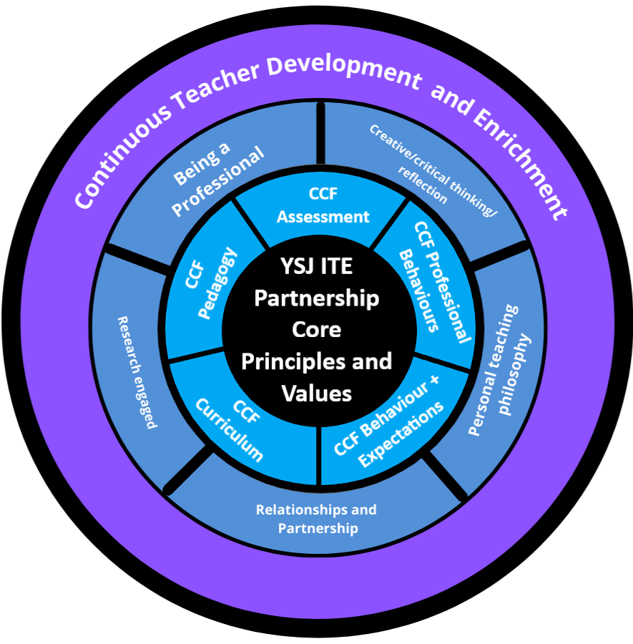

Slide 15
Positive Practice | Practice we would like to change
Dialogic nature of discussions with mentors | Lack of student teacher agency/self regulation
Triggers that allow us to celebrate and support | Driven by Ofsted and NASBTT
Ability to track progress | Too much importance on final grade
Reference to standards as an end point | Grade often has detrimental affect on progress and wellbeing
 | Mentors holding the power
 | Grading too early in the programme
Notes:
CER

Slide 16
Working Group
Programme Leads
Continuum Group
Wider Team

Slide 17
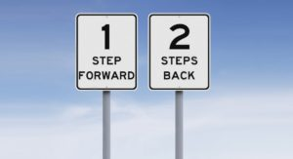
Sometimes it felt like….
‘That school-university partnerships are contestable and complex systems (Walkington 2007; Douglas 2012) is well accepted. They ‘can be sites of both struggle and enjoyment’ (Handscomb, Gu, and Varley 2014, 4). Collaboration in partnerships has been described by Adamson and Walker (2011) as messy in that it is complex, unpredictable and difficult to monitor or manage’ (Marsh, 2021, p.236)

Slide 18
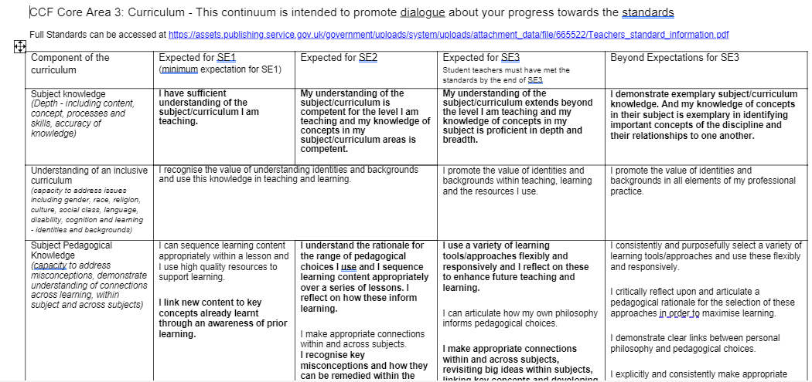
Links to CCF
Expectations for each SE (flexible)
Learner centred language
Statements in bold are core indicators
Notes:
CER

Slide 19
How student teachers should use this | How school mentors should use this
This is your living document so please refer to it and self-assess on an ongoing basis | This document is intended to be owned by the student teacher and it is their responsibility to keep it updated
Focus on a particular area(s) each week as outlined or suggested by the SE Director’s communications as well as areas identified by you and your mentor | Support the student teacher in identifying a suitable area of development for discussion
Focus on the core (bold) criteria and identify the aspects you have met and those that you feel can be developed further | The level of support is likely to change across the continua. SE1 might be characterised as co-construction, SE2 by support and SE3 by independence.
In consultation with your mentor or host teacher, co-construct actionable targets and identify actions to further improve your current stage. Discuss strategies to be able to meet your SMART targets | In consultation, and according to the point within the continuum, decide actionable targets and identify actions to further improve the current stage. Core criteria are in bold.
Self-review movement against targets through lesson evaluations and reflection before your next mentor meeting. Identify what you think are your next steps. | Ensure that the student teacher’s self-review movement against targets through lesson evaluations and reflections are realistic.
Bring evidence to discuss these during your next mentor meeting or discussion with host teacher. | Through dialogue, agree the next steps that have been identified and ensure that these are SMART targets.

Slide 20
Wider Implications
Mentor and Link Tutor training;
Opportunities for ongoing mentor professional development;
Student teacher briefings;
Student teacher ownership and responsibility;
Development of school-based tasks to compliment continuum;
Use for planning as well as assessment.

Slide 21
YSJ Initial Teacher Education Partnership Curriculum Design
Learn
Plan
Assess
CCF, YSJ Themes,
Curriculum Overview, Subject Maps
Taught Sessions, Modelling, School
Experience, School
Based Tasks,
Independent Research /Learning
What? | How?
This Photo by known Author is licensed under CC BY-SA
Formative Continuum, SE Reports, Academic Assessments

Slide 22
Any Questions ?

